Slide 1
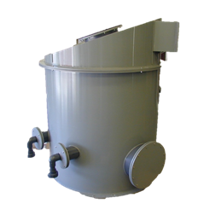
Chemical Systems Services, Inc.
Main Location|12 Field Rd. | Attleboro, Ma 02703
P | 508.431.9995
F | 508.431.9991
About Our
High Temperature Euro Grey Polypropylene
Density: 0.92 gm./cm3
Tensile strength at yield: 4,600 PSI
Continuous Operating Temperature:
239 degrees Fahrenheit
Flexural Modulus: 180,000 PSI
Hardness: 72 Shore D
¼” to 1” thickness & Custom Fabrication
TANK ADDITION
Yes We Can Do it!
www.ChemicalSystems.net | Info@ChemicalSystems.net

